Slide 1
Artificial intelligence
Session – 11
Date – 10th June, 2022

Slide 2
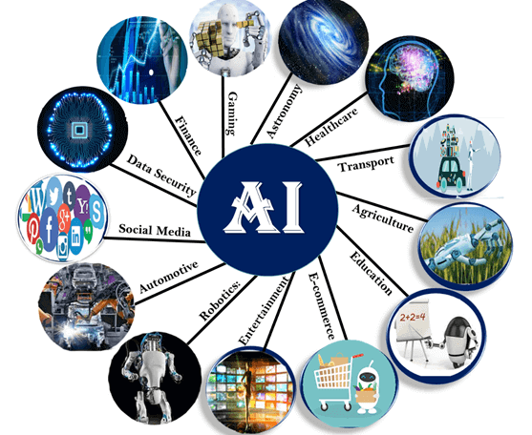
Application of AI
Artificial Intelligence has various applications in today's society. It is becoming essential for today's time because it can solve complex problems with an efficient way in multiple industries, such as Healthcare, entertainment, finance, education, etc. AI is making our daily life more comfortable and fast.
Following are some sectors which have the application of Artificial Intelligence:

Slide 3
Application of AI
1. AI in Astronomy
Artificial Intelligence can be very useful to solve complex universe problems. AI technology can be helpful for understanding the universe such as how it works, origin, etc.
2. AI in Healthcare
In the last, five to ten years, AI becoming more advantageous for the healthcare industry and going to have a significant impact on this industry.
Healthcare Industries are applying AI to make a better and faster diagnosis than humans. AI can help doctors with diagnoses and can inform when patients are worsening so that medical help can reach to the patient before hospitalization.
3. AI in Gaming
AI can be used for gaming purpose. The AI machines can play strategic games like chess, where the machine needs to think of a large number of possible places.
4. AI in Finance
AI and finance industries are the best matches for each other. The finance industry is implementing automation, chatbot, adaptive intelligence, algorithm trading, and machine learning into financial processes.
5. AI in Data Security
The security of data is crucial for every company and cyber-attacks are growing very rapidly in the digital world. AI can be used to make your data more safe and secure. Some examples such as AEG bot, AI2 Platform,are used to determine software bug and cyber-attacks in a better way.

Slide 4
Application of AI
6. AI in Social Media
Social Media sites such as Facebook, Twitter, and Snapchat contain billions of user profiles, which need to be stored and managed in a very efficient way. AI can organize and manage massive amounts of data. AI can analyze lots of data to identify the latest trends, hashtag, and requirement of different users.
7. AI in Travel & Transport
AI is becoming highly demanding for travel industries. AI is capable of doing various travel related works such as from making travel arrangement to suggesting the hotels, flights, and best routes to the customers. Travel industries are using AI-powered chatbots which can make human-like interaction with customers for better and fast response.
8. AI in Automotive Industry
Some Automotive industries are using AI to provide virtual assistant to their user for better performance. Such as Tesla has introduced TeslaBot, an intelligent virtual assistant.
Various Industries are currently working for developing self-driven cars which can make your journey more safe and secure.
9. AI in Robotics:
Artificial Intelligence has a remarkable role in Robotics. Usually, general robots are programmed such that they can perform some repetitive task, but with the help of AI, we can create intelligent robots which can perform tasks with their own experiences without pre-programmed.
Humanoid Robots are best examples for AI in robotics, recently the intelligent Humanoid robot named as Erica and Sophia has been developed which can talk and behave like humans.
10. AI in Entertainment
We are currently using some AI based applications in our daily life with some entertainment services such as Netflix or Amazon. With the help of ML/AI algorithms, these services show the recommendations for programs or shows.

Slide 5
Application of AI
12. AI in E-commerce
AI is providing a competitive edge to the e-commerce industry, and it is becoming more demanding in the e-commerce business. AI is helping shoppers to discover associated products with recommended size, color, or even brand.
13. AI in education:
AI can automate grading so that the tutor can have more time to teach. AI chatbot can communicate with students as a teaching assistant.
AI in the future can be work as a personal virtual tutor for students, which will be accessible easily at any time and any place.

Slide 6
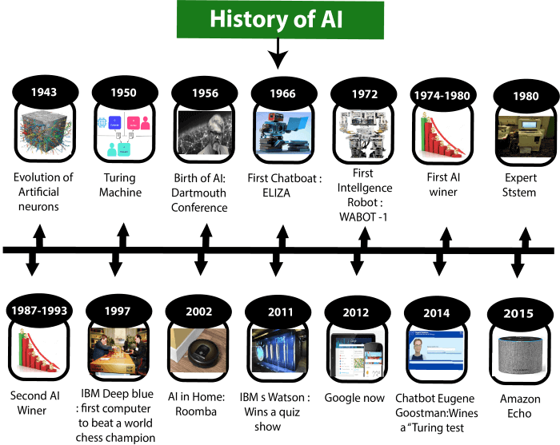
History of Artificial Intelligence
Artificial Intelligence is not a new word and not a new technology for researchers. This technology is much older than you would imagine. Even there are the myths of Mechanical men in Ancient Greek and Egyptian Myths. Following are some milestones in the history of AI which defines the journey from the AI generation to till date development.

Slide 7
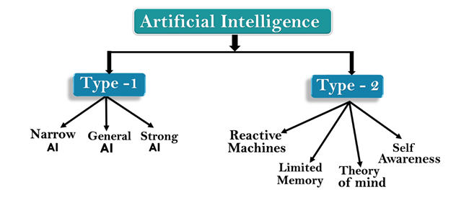
Types of Artificial Intelligence:
Artificial Intelligence can be divided in various types, there are mainly two types of main categorization which are based on capabilities and based on functionally of AI. Following is flow diagram which explain the types of AI.

Slide 8
AI type-1: Based on Capabilities
1. Weak AI or Narrow AI:
Narrow AI is a type of AI which is able to perform a dedicated task with intelligence.The most common and currently available AI is Narrow AI in the world of Artificial Intelligence.
Narrow AI cannot perform beyond its field or limitations, as it is only trained for one specific task. Hence it is also termed as weak AI. Narrow AI can fail in unpredictable ways if it goes beyond its limits.
Apple Siriis a good example of Narrow AI, but it operates with a limited pre-defined range of functions.
IBM's Watson supercomputer also comes under Narrow AI, as it uses an Expert system approach combined with Machine learning and natural language processing.
Some Examples of Narrow AI are playing chess, purchasing suggestions on e-commerce site, self-driving cars, speech recognition, and image recognition.

Slide 9
AI type-1: Based on Capabilities
2. General AI:
General AI is a type of intelligence which could perform any intellectual task with efficiency like a human.
The idea behind the general AI to make such a system which could be smarter and think like a human by its own.
Currently, there is no such system exist which could come under general AI and can perform any task as perfect as a human.
The worldwide researchers are now focused on developing machines with General AI.
As systems with general AI are still under research, and it will take lots of efforts and time to develop such systems.

Slide 10
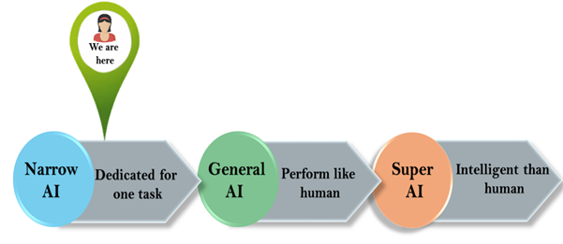
AI type-1: Based on Capabilities
3. Super AI:
Super AI is a level of Intelligence of Systems at which machines could surpass human intelligence, and can perform any task better than human with cognitive properties. It is an outcome of general AI.
Some key characteristics of strong AI include capability include the ability to think, to reason,solve the puzzle, make judgments, plan, learn, and communicate by its own.
Super AI is still a hypothetical concept of Artificial Intelligence. Development of such systems in real is still world changing task.

Slide 11
Artificial Intelligence type-2: Based on functionality
1. Reactive Machines
Purely reactive machines are the most basic types of Artificial Intelligence.
Such AI systems do not store memories or past experiences for future actions.
These machines only focus on current scenarios and react on it as per possible best action.
IBM's Deep Blue system is an example of reactive machines.
Google's AlphaGo is also an example of reactive machines.
2. Limited Memory
Limited memory machines can store past experiences or some data for a short period of time.
These machines can use stored data for a limited time period only.
Self-driving cars are one of the best examples of Limited Memory systems. These cars can store recent speed of nearby cars, the distance of other cars, speed limit, and other information to navigate the road.

Slide 12
Artificial Intelligence type-2: Based on functionality
3. Theory of Mind
Theory of Mind AI should understand the human emotions, people, beliefs, and be able to interact socially like humans.
This type of AI machines are still not developed, but researchers are making lots of efforts and improvement for developing such AI machines.
4. Self-Awareness
Self-awareness AI is the future of Artificial Intelligence. These machines will be super intelligent, and will have their own consciousness, sentiments, and self-awareness.
These machines will be smarter than human mind.
Self-Awareness AI does not exist in reality still and it is a hypothetical concept.

Slide 13
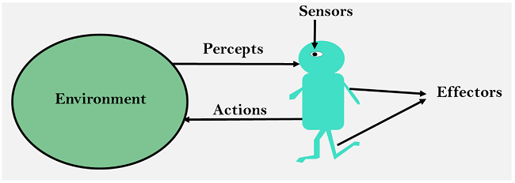
Agents in Artificial Intelligence
An AI system can be defined as the study of the rational agent and its environment. The agents sense the environment through sensors and act on their environment through actuators. An AI agent can have mental properties such as knowledge, belief, intention, etc.

Slide 14
What is an Agent?
An agent can be anything that perceiveits environment through sensors and act upon that environment through actuators. An Agent runs in the cycle of perceiving, thinking, and acting. An agent can be:
Human-Agent: A human agent has eyes, ears, and other organs which work for sensors and hand, legs, vocal tract work for actuators.
Robotic Agent: A robotic agent can have cameras, infrared range finder, NLP for sensors and various motors for actuators.
Software Agent: Software agent can have keystrokes, file contents as sensory input and act on those inputs and display output on the screen.
Hence the world around us is full of agents such as thermostat, cellphone, camera, and even we are also agents.
Before moving forward, we should first know about sensors, effectors, and actuators.
Sensor: Sensor is a device which detects the change in the environment and sends the information to other electronic devices. An agent observes its environment through sensors.
Actuators: Actuators are the component of machines that converts energy into motion. The actuators are only responsible for moving and controlling a system. An actuator can be an electric motor, gears, rails, etc.
Effectors: Effectors are the devices which affect the environment. Effectors can be legs, wheels, arms, fingers, wings, fins, and display screen.

Slide 15
Intelligent Agents:
An intelligent agent is an autonomous entity which act upon an environment using sensors and actuators for achieving goals. An intelligent agent may learn from the environment to achieve their goals. A thermostat is an example of an intelligent agent.
Following are the main four rules for an AI agent:
Rule 1: An AI agent must have the ability to perceive the environment.
Rule 2: The observation must be used to make decisions.
Rule 3: Decision should result in an action.
Rule 4: The action taken by an AI agent must be a rational action.

Slide 16
Rational Agent:
A rational agent is an agent which has clear preference, models uncertainty, and acts in a way to maximize its performance measure with all possible actions.
A rational agent is said to perform the right things. AI is about creating rational agents to use for game theory and decision theory for various real-world scenarios.
For an AI agent, the rational action is most important because in AI reinforcement learning algorithm, for each best possible action, agent gets the positive reward and for each wrong action, an agent gets a negative reward.

Slide 17
Rationality:
The rationality of an agent is measured by its performance measure. Rationality can be judged on the basis of following points:
Performance measure which defines the success criterion.
Agent prior knowledge of its environment.
Best possible actions that an agent can perform.
The sequence of percepts.

Slide 18
Structure of an AI Agent
The task of AI is to design an agent program which implements the agent function. The structure of an intelligent agent is a combination of architecture and agent program. It can be viewed as:
Agent = Architecture + Agent program
Following are the main three terms involved in the structure of an AI agent:
Architecture: Architecture is machinery that an AI agent executes on.
Agent Function: Agent function is used to map a percept to an action.
Agent program: Agent program is an implementation of agent function. An agent program executes on the physical architecture to produce function f.

Slide 19
PEAS Representation
PEAS is a type of model on which an AI agent works upon. When we define an AI agent or rational agent, then we can group its properties under PEAS representation model. It is made up of four words:
P: Performance measure
E: Environment
A: Actuators
S: Sensors
Here performance measure is the objective for the success of an agent's behavior.

Slide 20
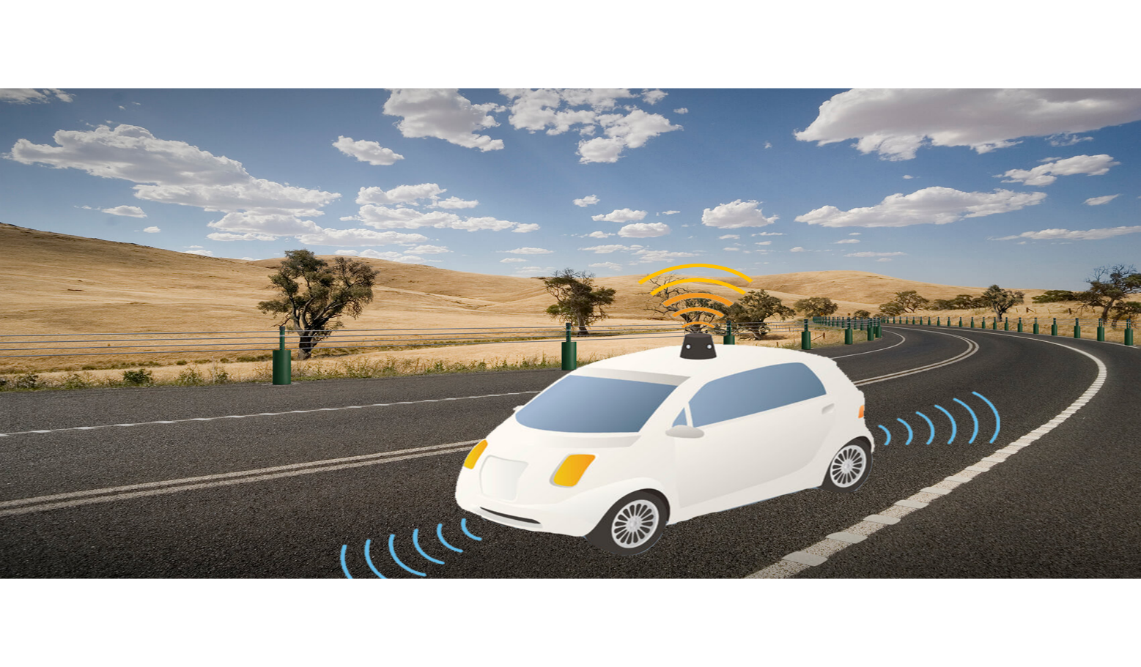
PEAS for self-driving cars:

Slide 21
PEAS for self-driving cars:
Let's suppose a self-driving car then PEAS representation will be:
Performance: Safety, time, legal drive, comfort
Environment: Roads, other vehicles, road signs, pedestrian
Actuators: Steering, accelerator, brake, signal, horn
Sensors: Camera, GPS, speedometer, odometer, accelerometer, sonar.

Slide 22
Example of Agents with their PEAS representation
Agent | Performance measure | Environment | Actuators | Sensors
1. Medical Diagnose | Healthy patient Minimized cost | Patient Hospital Staff | Tests Treatments | Keyboard (Entry of symptoms)
2. Vacuum Cleaner | Cleanness Efficiency Battery life Security | Room Table Wood floor Carpet Various obstacles | Wheels Brushes Vacuum Extractor | Camera Dirt detection sensor Cliff sensor Bump Sensor Infrared Wall Sensor
3. Part -picking Robot | Percentage of parts in correct bins. | Conveyor belt with parts, Bins | Jointed Arms Hand | Camera Joint angle sensors.

Slide 23
Types of AI Agents
Agents can be grouped into five classes based on their degree of perceived intelligence and capability. All these agents can improve their performance and generate better action over the time. These are given below:
Simple Reflex Agent
Model-based reflex agent
Goal-based agents
Utility-based agent
Learning agent

Slide 24
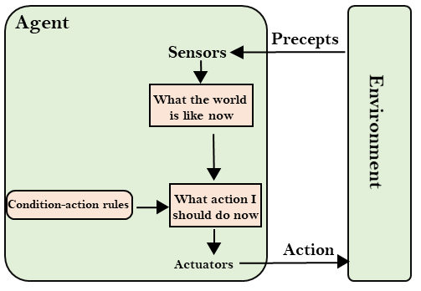
Simple Reflex agent:
The Simple reflex agents are the simplest agents. These agents take decisions on the basis of the current percepts and ignore the rest of the percept history.
These agents only succeed in the fully observable environment.
The Simple reflex agent does not consider any part of percepts history during their decision and action process.
The Simple reflex agent works on Condition-action rule, which means it maps the current state to action. Such as a Room Cleaner agent, it works only if there is dirt in the room.
Problems for the simple reflex agent design approach:
They have very limited intelligence
They do not have knowledge of non-perceptual parts of the current state
Mostly too big to generate and to store.
Not adaptive to changes in the environment.

Slide 25
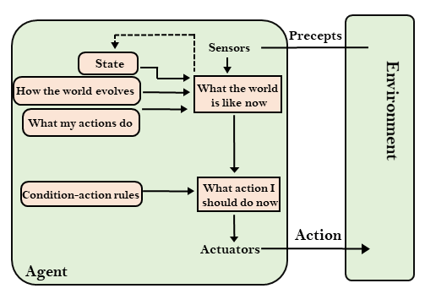
Model-based reflex agent
The Model-based agent can work in a partially observable environment, and track the situation.
A model-based agent has two important factors:
Model: It is knowledge about "how things happen in the world," so it is called a Model-based agent.
Internal State: It is a representation of the current state based on percept history.
These agents have the model, "which is knowledge of the world" and based on the model they perform actions.
Updating the agent state requires information about:
How the world evolves
How the agent's action affects the world.

Slide 26
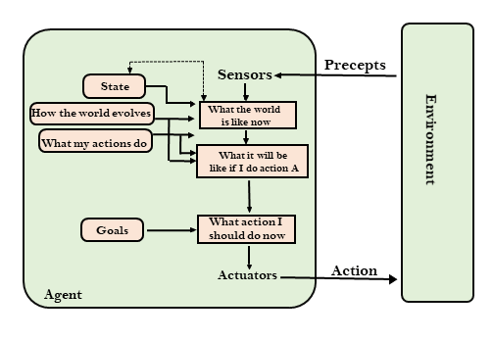
Goal-based agents
The knowledge of the current state environment is not always sufficient to decide for an agent to what to do.
The agent needs to know its goal which describes desirable situations.
Goal-based agents expand the capabilities of the model-based agent by having the "goal" information.
They choose an action, so that they can achieve the goal.
These agents may have to consider a long sequence of possible actions before deciding whether the goal is achieved or not. Such considerations of different scenario are called searching and planning, which makes an agent proactive.

Slide 27
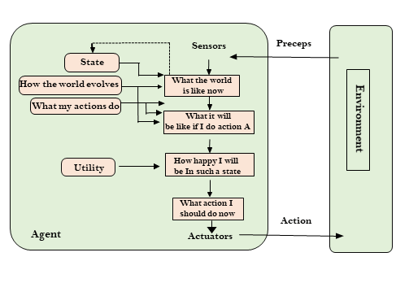
Utility-based agents
These agents are similar to the goal-based agent but provide an extra component of utility measurement which makes them different by providing a measure of success at a given state.
Utility-based agent act based not only goals but also the best way to achieve the goal.
The Utility-based agent is useful when there are multiple possible alternatives, and an agent has to choose in order to perform the best action.
The utility function maps each state to a real number to check how efficiently each action achieves the goals.

Slide 28
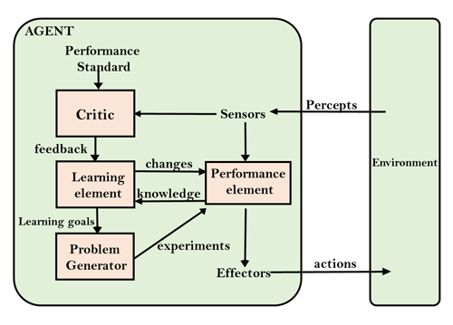
Learning Agents
A learning agent in AI is the type of agent which can learn from its past experiences, or it has learning capabilities.
It starts to act with basic knowledge and then able to act and adapt automatically through learning.
A learning agent has mainly four conceptual components, which are:
Learning element: It is responsible for making improvements by learning from environment
Critic: Learning element takes feedback from critic which describes that how well the agent is doing with respect to a fixed performance standard.
Performance element: It is responsible for selecting external action
Problem generator: This component is responsible for suggesting actions that will lead to new and informative experiences.
Hence, learning agents are able to learn, analyze performance, and look for new ways to improve the performance.

